Slide 1

Automotive Product Knowledge Training

Slide 2
Lubricant Function and Properties
Separation of mating surfaces /
friction Reduction
Example
Bearing Shell
Journal
Oil Film

Slide 3
Lubricant Function and Properties
Cooling – Heat Transfer
Cool Oil

Slide 4
Typical Engine Temperatures
250 / 350 ºC
100 / 150 ºC
80 / 130 ºC

Slide 5
Typical Engine Temperatures
Component | Temp ºC
 | From | To
Upper Cylinder Wall | 150 | 260
Exhaust Valve | 650 | 815
Piston Crown | 370 | 425
Hydraulic Valve Lifter | 120 | 150
Crankcase | 93 | 150
Top Ring | 150 | 340
Exhaust Gases | 260 | 540
Combustion Chamber | 1650 | 2760
Coolant Jacket | 75 | 110
Connecting Rod Bearings | 93 | 190
Main Bearings | 93 | 175

Slide 6
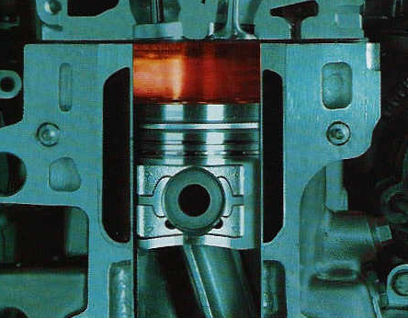
Lubricant Function and Properties
Contamination Containment
Carbon
Water
Acids
Partially Burnt Fuel
Varnish
Lacquers

Slide 7
Base Oils and Additives

Slide 8
Formulating Lubricants
Base Oil
  The main component of the formulation
  Selection based on the lubricant application
Main types
  Mineral Oils – Mainstream products
  Vegetable Oils – Biodegradable, historic
  Synthetic Fluids – High performance, extremes

Slide 9
Formulating Lubricants
Mineral Oils:
  Advantages: Relative low cost, variety of natural viscosities, widely available
  Disadvantages: Requires additive enhancement, limited high temperature performance (oxidation resistance)
Synthetic Oils:
  Advantages: Good cold flow, excellent high temperature performance (oxidation resistance), low deposit formation, maintains better viscosity at elevate temperatures, forms a strong oil film
  Disadvantages: Poor natural lubricity, possible seal shrinkage, expensive
Vegetable Oils:
  Advantages: High film strength, excellent natural lubricity
  Disadvantages: Poor high temperature performance (oxidation resistance), tendency to thicken, forms lacquers and varnishes, frequent oil drain, not compatible with mineral oils, poor cold start

Slide 10
Formulating Lubricants
Additives:
Enhance base oil performance
Imparts required lubricant functions
Main types:
Detergent
Dispersants
Anti-wear
Corrosion inhibitor
Rust inhibitor
Oxidation inhibitor
Pour Point Depressant
EP (Extreme Pressure)
Seal swell
Friction modifier
Tackiness Additive
Anti-foam

Slide 11
Basic Terminology

Slide 12
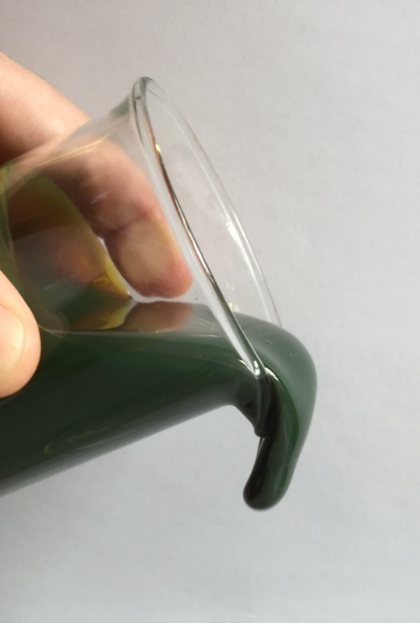
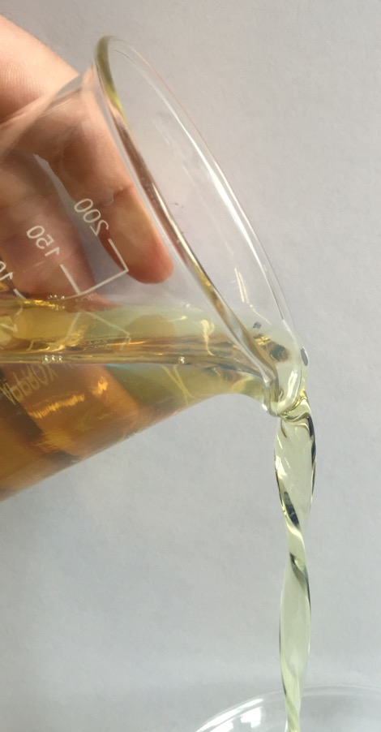
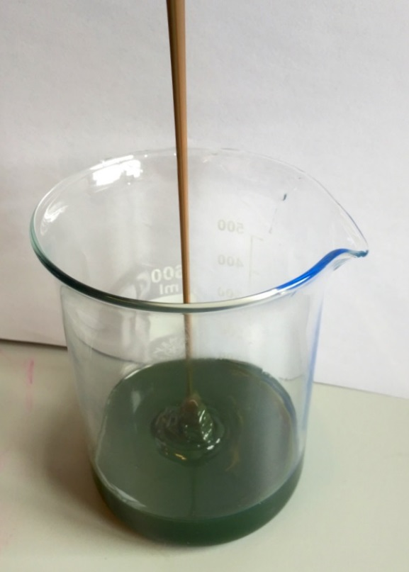
What is viscosity?
Thin Oil
Low Viscosity
Thick Oil
High Viscosity

Slide 13
Viscosity Classifications
SAE – Society of Automotive Engineers
ISO – International Standards Organisation

Slide 14
Multigrade Engine Oils
0ºC
20W
-15ºC
15W
10W
-20ºC
5W
0W
-25ºC
-30ºC
-35ºC
A measure of the oil’s
cold start fluidity.

Slide 15
LEGISLATION – EMISSIONS
AND
ENGINE HARDWARE

Slide 16
Targeted Pollutants
NO_{x}
  Nitrous oxide (NO), poisonous gas
  Nitrogen dioxide (NO₂), can cause respiratory problems
  Produces Ozone (O₃) in strong sunlight
  Contributes to acid rain
Hydrocarbon (HC) and Particulates (PM)
  Unburnt fuel and soot
  Harmful to health
  Smog formation
Carbon Monoxide (CO)
  CO, poisonous gas
CO₂
  Carbon Dioxide, colourless, inert gas
  Greenhouse gas
SO_{2,} SO₃
  Sulphur Dioxide / Trioxide
  Formed during combustion from sulphur
  Breathing difficulties with asthmatics
  Acid rain – Sulphuric acid

Slide 17
Emissions Legislation – On Road
EU Emission Standards for Heavy Duty Diesel Engines (Lorries/Buses)
Standard |  | CO | HC | NOx | PM | Smoke
Euro 1 | 1992,<85kW 1992,>85kW | 4.5 4.5 | 1.1 1.1 | 8.0 8.0 | 0.612 0.36 | -
Euro 2 | Oct 1996 Oct 1998 | 4.0 4.0 | 1.1 1.1 | 7.0 7.0 | 0.25 0.15 | -
Euro 3 | Oct 1999* Oct 2000 | 1.0 2.1 | 0.25 0.66 | 2.0 5.0 | 0.02 0.10 | 0.15 0.8
Euro 4 | Oct 2005 | 1.5 | 0.46 | 3.5 | 0.02 | 0.5
Euro 5 | Oct 2008 | 1.5 | 0.46 | 2.0 | 0.02 | 0.5
Euro 6 | Sept 2014 | 1.5 | 0.13 | 0.4 | 0.01
Units in g/kWh, Smoke in m^{-1 *}Enhanced Environmentally Friendly vehicles only

Slide 18
Emissions Legislation – Off-Highway
Environmental Protection Agency (U.S.A.)
European Union (EU)
Emissions Legislation for Non-road Diesel Engines
EPA | EU | Date
Tier 1 | Stage I | 1996 - 1999
Tier 2 | Stage II | 2001 - 2004
Tier 3 | Stage IIIA | 2006 - 2008
Interim Tier 4 | Stage IIIB | 2008 - 2013
Final Tier 4 | Stage 4 | 2012 - 2015

Slide 19
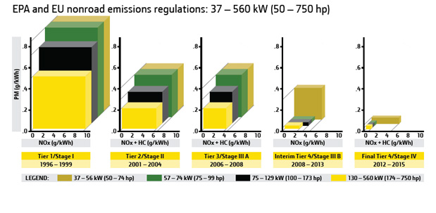
Emissions Legislation – Off-Highway

Slide 20
Diesel Emissions - Reduction Technologies
Exhaust Gas Re-circulation (EGR)
  NOx reduction
  The oil must combat: thickening, wear and corrosion
Diesel Particulate Filters (DPF)
  Particulate matter (PM) reduction
  The oil must not form excessive ash
Selective Catalytic Reduction (SCR) - Adblue
  NOx reduction
  The oil must be catalyst safe
New generation SAPS products (Sulphated Ash / Sulphur / Phosphorous )

Slide 21
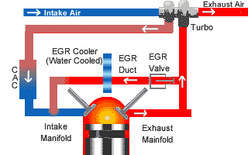
Exhaust Gas Recirculation (EGR)
NO_{x} reduction
More aggressive engine environment
Significant impact on lubricants

Slide 22
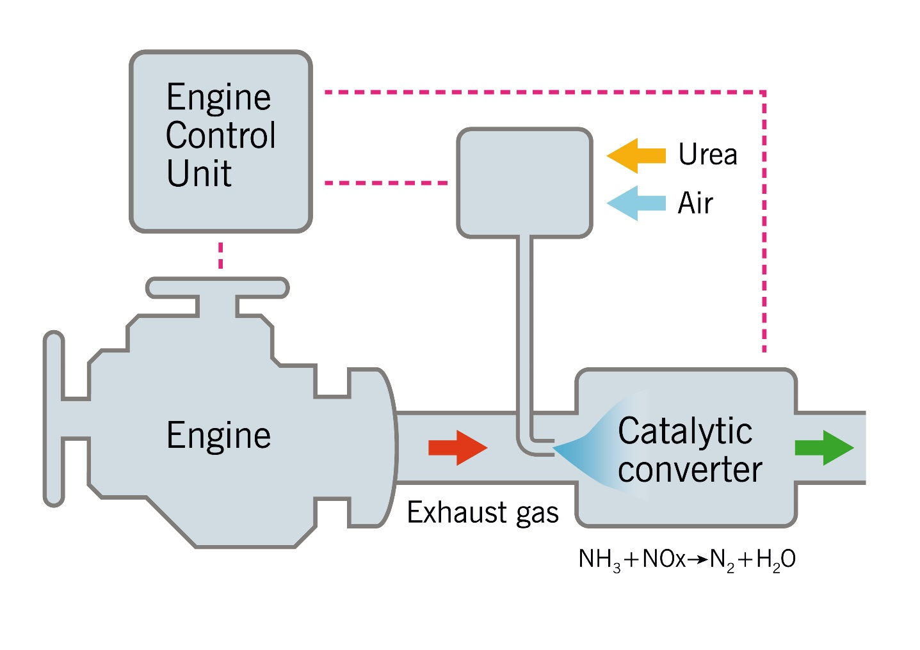
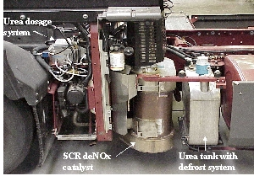
Selective Catalytic Reduction (SCR)
NO_{x} reduction
Less demand on the engine environment
Sulphate formation can deactivate SCR by fouling the catalyst

Slide 23
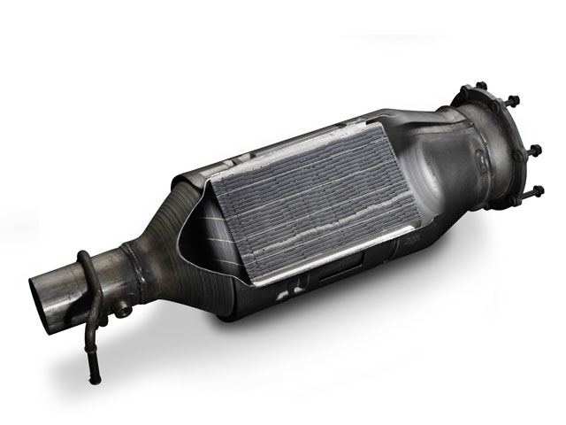
Diesel Particular Filters (DPFs)
Particulate Matter (PM) reduction
Sensitive to ash levels
Sulphated Ash level critical

Slide 24
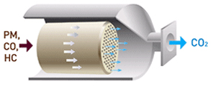
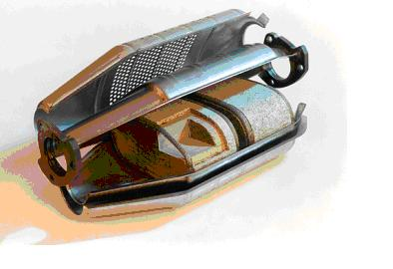
Diesel Oxidation Catalysts (DOC)
Reduction of carbon
monoxide and
hydrocarbons by
more than 90%
Reduction of particulate
emissions
Phosphorous / Sulphur can
poison catalyst

Slide 25
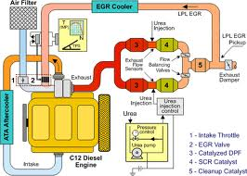
Euro 6 Approach - All 3 Technologies
Intake Throttle
EGR Valve
DPF
SCR Catalyst
Cleanup Catalyst
As proposed by Scania

Slide 26
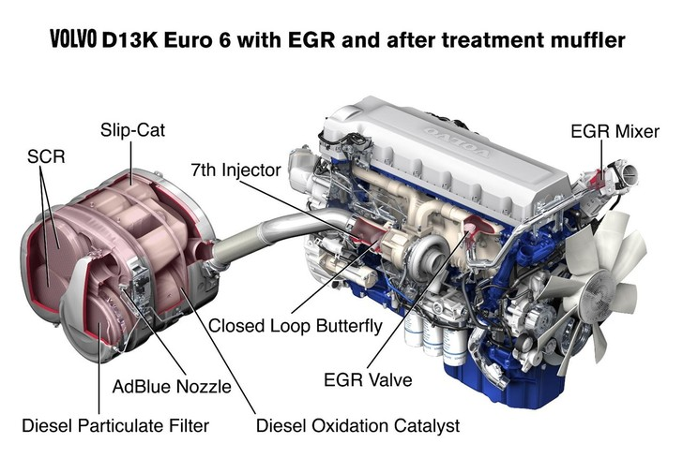
Euro 6 Approach - All 3 Technologies

Slide 27
PERFORMANCE LEVELS

Slide 28
New Chemical Restrictions on Lubricants
New generation of after-treatment compatible
lubricants
New additive systems developed to maintain
after-treatment efficiency
SAPS
Sulphated Ash | Originates from the combustion of engine oil additive systems
Phosphorous | Originates from engine oil additive systems
Sulphur | Originates from base fluids and additive systems, fuel

Slide 29
Engine Oil Performance Classifications
ACEA
Association des Constructeurs Europeens de l’Automobile
(Association of European Automotive Manufacturers)
Category | Description
A | Gasoline / Petrol Engines
B | Light Duty Diesel Engines
C | Gasoline / Light Duty Diesel Engines with exhaust after-treatments
E | Heavy Duty Diesel Engines, including latest technology designs
API
American Petroleum Institute
Category | Description
C | Commercial – Compression Ignition - Diesel
S | Service – Spark Ignition – Petrol / Gasoline

Slide 30
ACEA - Performance Classifications
Passenger Car |  | Heavy Duty Diesel
Engines without After-treatment | Engines with After-treatment
Gasoline / Diesel | Gasoline / Diesel
A1 / B1* | C1 Low SAPS | E4 Conventional *
A3 / B3* | C2 Mid SAPS | E7 Conventional *
A3 / B4* | C3 Mid SAPS | E6 Low SAPS
A5 / B5* | C4 Low SAPS | E9 Mid SAPS
* Cannot be used with Diesel Particulate Filters

Slide 31
Understanding API Designations
API SN / CI-4
Spark Ignition
Service Category
Petrol
Compression Ignition
Commercial Category
Diesel

Slide 32
API Service Categories - Petrol

Slide 33
API Commercial Categories - Diesel

Slide 34
BASIC GEAR OIL
PERFORMANCE LEVELS

Slide 35

Basic EP (Extreme Pressure) Properties
Sacrificial Chemical Layer

Slide 36
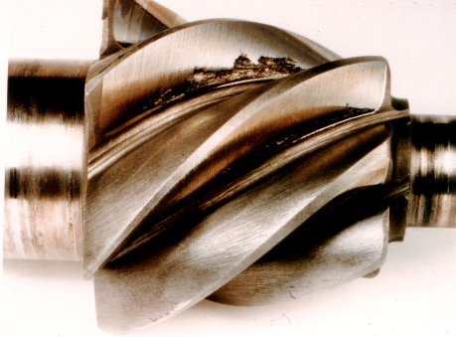
POOR RESULT
PINION SHAFTS SEVERE 400 HR TEST

Slide 37
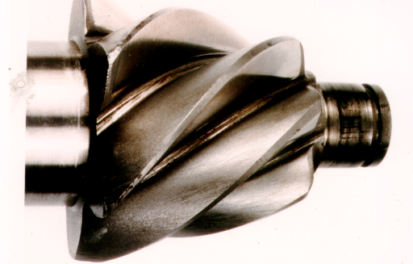
GOOD RESULT
PINION SHAFTS SEVERE 400 HR TEST

Slide 38
Automotive Gear Oils – API GL Specifications
API GL-1 Straight mineral oil
API GL-2 Mild EP for worm gears
API GL-3 Mild EP for spur and spiral bevel gears
in axles and transmissions
API GL-4 Medium EP, MIL-L-2105 quality, moderate
severity hypoid gears, manual transmissions
API GL-5 High EP, MIL-L-2105D quality, all hypoid
axles, some manual transmissions
API GL-6 Extra high EP, now obsolete

Slide 39
Automatic Transmission Fluids

Slide 40
ATF - GM Service Fill History

Slide 41
ATF - Ford Service Fill History

Slide 42
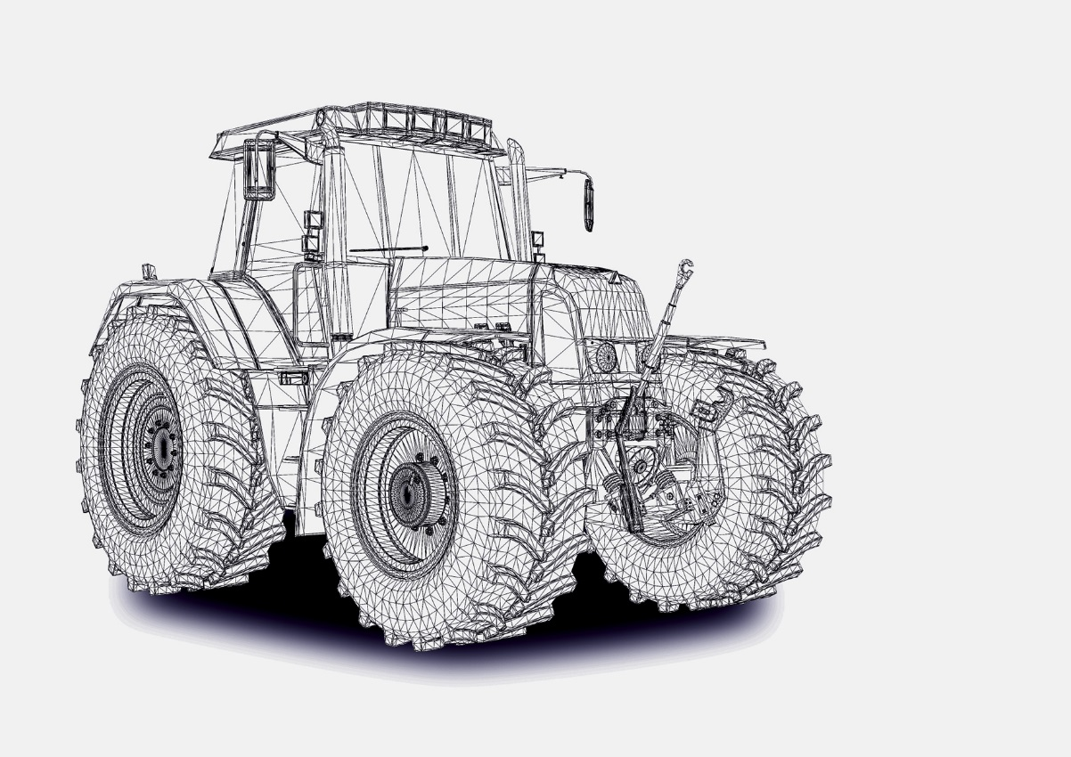
Agricultural Sector

Slide 43
A few acronyms:
STOU – Super Tractor Oil Universal
SUTO – Super Universal Tractor Oil
UTTO – Universal Tractor Transmission Oil
THF – Transmission Hydraulic Fluid

Slide 44
Historic Overview
Year | Lubricant Types
Pre-1980 | Combination of Engine Oil, Standard Gear Oil, STOU (15W-30).
1980 - 1989 | Mixture of Engine Oil, STOU (15W-30 & 10W-30), Dedicated Transmission Fluids, some Standard Gear Oils.
1990 -1999 | Mixture of Engine Oil, STOU (10W-30) and Dedicated Transmission Fluids, some Standard Gear Oils.
2000- | Specific Engine Oil, Dedicated Transmission Oil, fewer allowances for STOU (10W-30), some Standard Gear Oils.

Slide 45
Main Categories of Agricultural Lubricant
Engine Oils
Specific to engine OEMs requirements, emissions hardware, etc.
Dedicated Transmission Fluids (not engine)
Universal Tractor Transmission Oil (UTTO)
  Main drive system
  Wet brakes
  Power-takes offs
  Differentials
  Final reduction gears
  Torque converter
  Hydraulic System
Universal Oils (Engine and transmission)
  In decline – no future developments

Slide 46
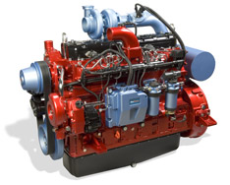
Critical Choices – Engines
Lubricant must be compatible with any emission reduction technologies.
Protect under a wide range of workloads and environments:
  High speed road work / slow, high load, off-highway
Developments:
  Interim Tier 4 / Stage IIIB
    Selective Catalytic Reduction (Adblue) + EGR
    Level: API CI-4, ACEA E7
  Tier 4 / Stage 4
    Diesel Particulate Filters (+ EGR + Adblue)
    Level: API CJ-4, ACEA E9

Slide 47
Critical Choices – Transmission and Hydraulic Systems
Performance is optimised by using the correct fluid as designated by the OEM.
Increased complexity in design:
  Increased levels of electronic control
  Variety of operational modes (semi-auto / full auto)
  Continuously Variable Transmissions (CVTs):
Improved durability to cope with a variety of workloads:
    Address critical frictional requirements, i.e. clutch packs, wet brakes
    Protect gear components, bearings and bushes
    Remove heat and debris
    Provide the correct hydraulic response in terms of speed and precision

Slide 48
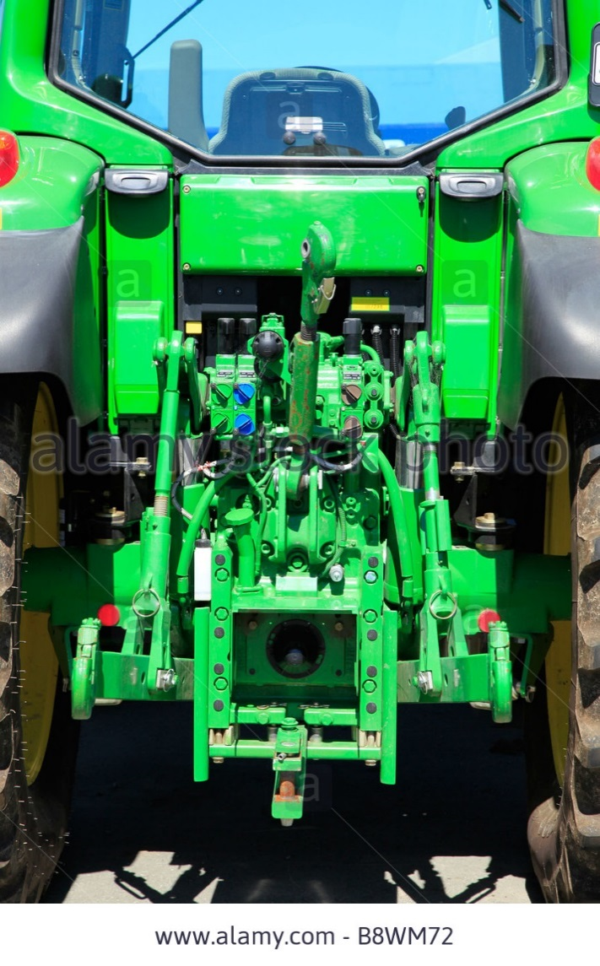
Critical Choices – Transmission and Hydraulic Systems
Typical Specifications:
UTTO
  GIMA M1143
  Massey Ferguson M1135 / M1145
  CNH MAT 3525 (Ford ESN-M2C134D Fluid)
  John Deere J20C
  ZF TE-ML-03E / 05F / 06K

Slide 49

Critical Choices – Multipurpose Lubricants (STOU)
Balance engine oil chemistry with transmission / hydraulic function
Long term future limited:
  More severe engine environments – low emissions
  Increased transmission sophistication

Slide 50
Critical Choices – Multipurpose Lubricants (STOU)
Typical Specifications:
MF M-1145 | API CG-4
MF M-1144 / M-1139 | MB 227.1
Ford M2C-159B / M2C-121B | MB 228.3
John Deere JDM J27 | MIL-L-2104D
ZF TE-ML 06B (includes C,Q,R)
ZF TE-ML 06D, 06F, 07B
API GL-4
Allison C4
Caterpillar T0-2

